Slide 1

Introduction to AI (AI101B) EVEN Semester Session 2024-25
Noughts and Crushes using Alpha-Beta Pruning
Aman Kumar 202410116100020
Alok Kumar 202410116100018
Anand Patel 202410116100023
Ambikeshwar Dutt Dwivedi 202410116100022
Project Supervisor:
Mr. Apoorv Jain

Slide 2
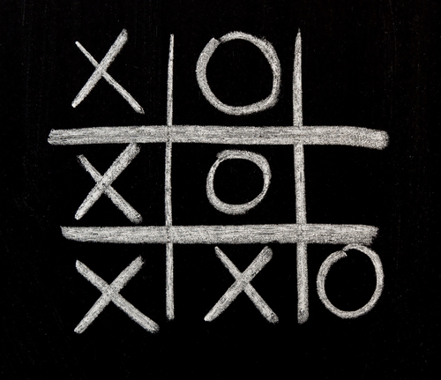
Introduction to Naughts and Crosses
Naughts and Crosses, also known as Tic-Tac-Toe, is a classic and simple game. Its simplicity makes it an ideal candidate for learning and implementing artificial intelligence algorithms. This presentation will guide you through the process of creating an AI that can play Naughts and Crosses using the Alpha-Beta Pruning algorithm, a powerful optimization technique for the Minimax algorithm. The game involves two players, typically represented by "X" and "O." The objective is straightforward: each player aims to get three of their marks in a row, either horizontally, vertically, or diagonally, before the other player.

Slide 3
Game Tree Representation
The game tree is a way to visualize all potential game states. At the root is the initial empty board. Branches emanate from this node, representing all the possible moves a player can make. Each branch leads to another game state, reflecting the updated board after the move. This branching continues until the leaf nodes are reached, representing the end of the game, where one player has won, or the game ends in a draw.
The complexity of Naughts and Crosses stems from the large number of possible board states. While there are 3^9 (or 19,683) possible board states in theory, many of these are redundant due to symmetries and the fact that the game can end before all nine squares are filled. However, it's still important to have a strategy.

Slide 4


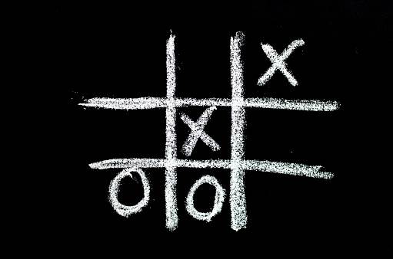
Minimax Algorithm: The Foundation
The Minimax algorithm is the foundation for creating an AI that plays Naughts and Crosses optimally. In a perfect game of Naughts and Crosses, both players will play flawlessly, guaranteeing a draw. The Minimax algorithm aims to find the optimal move for the AI, ensuring it never loses. The algorithm works by assuming that both players are playing optimally.
There are two types of players in the Minimax algorithm: the maximizing player (typically "X," which we assume is the AI) and the minimizing player (typically "O," the opponent). The maximizing player wants to make moves that result in the highest possible score, while the minimizing player wants to make moves that result in the lowest possible score.

Slide 5
Alpha-Beta Pruning: Efficiency Booster
Alpha-Beta Pruning is an optimization technique for the Minimax algorithm. It allows the AI to make decisions more efficiently by avoiding the exploration of unnecessary branches in the game tree. Think of it like a shortcut that eliminates moves that are clearly not beneficial.
Alpha represents the best score that the maximizing player (AI) has found so far along a certain path in the game tree. Conversely, Beta represents the best score that the minimizing player (opponent) has found so far along a path.
The algorithm works by comparing Alpha and Beta values at each node. If, at any point, Alpha becomes greater than or equal to Beta, it means that the remaining branches under that node cannot possibly improve the result for either player, so they can be "pruned," which drastically reduces the search space, making the AI faster and more efficient.

Slide 6
Alpha-Beta in Action: Example
Let's illustrate how Alpha-Beta Pruning works in practice. The algorithm starts with initial Alpha and Beta values set to -infinity and +infinity, respectively. As the algorithm explores different moves, it updates these Alpha and Beta values based on the scores encountered.
If, during the exploration, the algorithm finds a move that leads to a better score for the maximizing player (X), it updates the Alpha value. Similarly, if it finds a move that leads to a better score for the minimizing player (O), it updates the Beta value. When Alpha becomes greater than or equal to Beta at any node, a cutoff occurs. The cutoffs dramatically reduce the number of nodes that the AI needs to evaluate, saving computational resources.
By eliminating these unproductive branches, Alpha-Beta Pruning enables the AI to analyze the game tree more efficiently and make informed decisions.

Slide 7
Implementing Alpha-Beta for Naughts and Crosses
Implementing Alpha-Beta Pruning for Naughts and Crosses involves several key steps. First, you need to define a way to represent the board. A common approach is to use a 2D array. Then, you need to create a function that can generate all possible moves from a given board state.
Crucially, you'll need to implement an evaluation function that assigns a score to a given board state. This function should return a positive score if the AI is winning, a negative score if the opponent is winning, and zero for a draw. Finally, you'll implement the Alpha-Beta search recursively, using the move generation and evaluation functions to explore the game tree and make decisions. The depth limit is chosen to balance speed and accuracy.

Slide 8
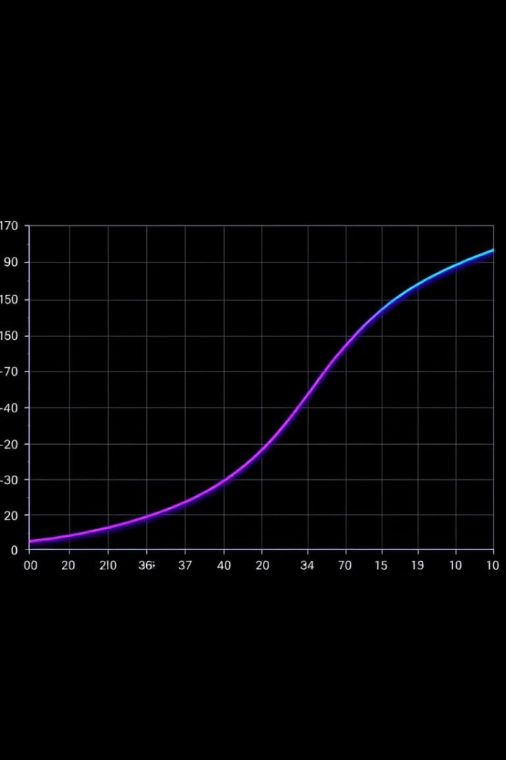
Results and Analysis
When implemented correctly, the Alpha-Beta Pruning algorithm delivers impressive results. It consistently finds optimal moves for Naughts and Crosses, ensuring that the AI never loses when playing against an optimal opponent. Compared to the plain Minimax algorithm, Alpha-Beta Pruning is drastically faster. The depth limit chosen for the search has a significant impact on the AI's performance. A deeper search allows the AI to see further into the future.
With a sufficient depth limit, the AI can become virtually unbeatable. The memory requirements for Alpha-Beta Pruning are relatively modest, often requiring less than 1MB of RAM.

Slide 9

Limitations and Extensions
Although Alpha-Beta Pruning is a powerful technique, it has limitations. It still requires significant computation for more complex games. The depth limit can introduce the "horizon effect," where the AI might make a suboptimal decision because it cannot see far enough into the future.
To overcome these limitations, you can combine Alpha-Beta Pruning with other optimization techniques such as transposition tables. These tables store previously evaluated board states.
The principles learned from implementing Alpha-Beta Pruning for Naughts and Crosses can be extended to other games like Connect Four, Checkers, or even Chess.

